Slide 1


Dr. D.Y. Patil College of Engineering and Innovation, Pune
A Presentation
On
Reflectech : The Smart Mirror
Under the Guidance
Of
Mr. Santosh Kawade
By
Tanuja Waware (14366)
Divya Rathod (14315)
Amrut Taki (14345)
Meghna Tighare (14358)

Slide 2
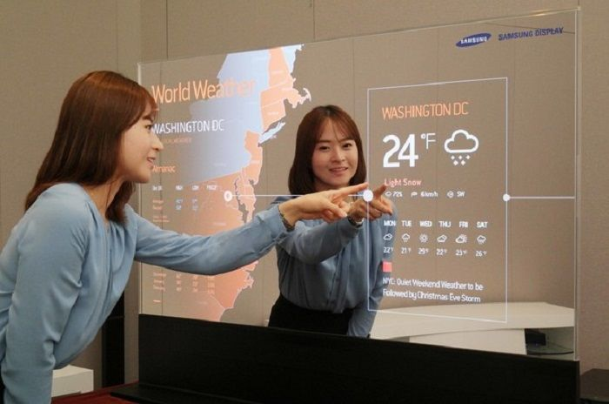
CONTENTS
Introduction
Problem statement
Project Objectives & Goals
Project Scope
Methodology/ Approach
Results/finding
Conclusion
Future Work
References

Slide 3
Introduction
A smart mirror is a next-generation device that combines traditional reflective surfaces with digital displays to provide an interactive and connected experience. Beyond serving as a regular mirror, it can display information such as the time, weather, news, and calendar events.
Some smart mirrors are equipped with voice control, touch interfaces, and even facial recognition, allowing users to interact with them seamlessly.
By integrating with smart home systems and various apps, smart mirrors offer enhanced convenience, personalization, and functionality, making daily routines more efficient and informed.
A smart mirror is an innovative device that combines the functionality of a traditional mirror with advanced technology to provide interactive features and information.

Slide 4
Problem statement
The problem is to create a smart mirror that effectively integrates a calendar and customizable widgets, providing users with real-time information and a personalized interface to enhance daily productivity and convenience.

Slide 5
Project Objectives & Goals
Goal :-
To develop an intelligent smart mirror interface that seamlessly integrates calendar functionalities and customizable widgets, enhancing user experience through real-time information display, easy interaction, and a personalized dashboard tailored to individual needs.
Objectives:-
Integrate Calendar Functionality: Implement a user-friendly calendar system that syncs with existing calendars to display events, reminders, and daily schedules.
Develop Customizable Widgets: Create a set of customizable widgets for displaying information such as weather, news, time, and notifications, allowing users to personalize their smart mirror experience

Slide 6
Ensure Real-Time Updates: Enable real-time data synchronization for all widgets and calendar events to keep users updated with the latest information.
Optimize User Interaction: Design an intuitive user interface with support for touch or voice commands to facilitate easy navigation and interaction with the smart mirror.
Provide a Seamless User Experience: Ensure the system is responsive, visually appealing, and seamlessly integrated into the user's daily routine, enhancing productivity and convenience.

Slide 7
Project Scope
Calendar Integration:
Sync with existing calendar platforms (e.g., Google Calendar, Microsoft Outlook).
Display daily events, reminders, and notifications in an intuitive format.
Customizable Widgets:
Develop widgets for displaying weather, news, time, and other relevant information.
Allow users to personalize the arrangement and selection of widgets.
User Interaction:
Implement touch and voice command functionalities for easy navigation.
Ensure the user interface is visually appealing and intuitive.

Slide 8
Project Scope
Real-Time Updates:
Integrate APIs to provide live updates for calendar events and widget content.
Performance Monitoring:
Track user engagement and feedback to optimize features and performance.

Slide 9
Methodology/ Approach
Design Phase: Initiated with sketching the layout and user interface for the smart mirror, ensuring a balance between aesthetics and functionality.
Hardware Integration: Raspberry Pi was used as the main controller, integrated with a two-way mirror, display monitor, PIR sensor, and necessary power supply.
Software Development: Developed a modular dashboard using Python and JavaScript. Integrated APIs for real-time weather updates, calendar events, and news feeds. Facial recognition and voice assistant features were implemented using OpenCV and speech recognition libraries.
Testing and Debugging: Each module was tested individually and later integrated for final testing on the mirror setup

Slide 10
Results/finding
The smart mirror successfully displayed real-time information like time, weather, calendar events, and daily news headlines.
The user interface was responsive and intuitive.
Facial recognition worked well for known users, with scope for further improvement in varying lighting conditions.

Slide 11
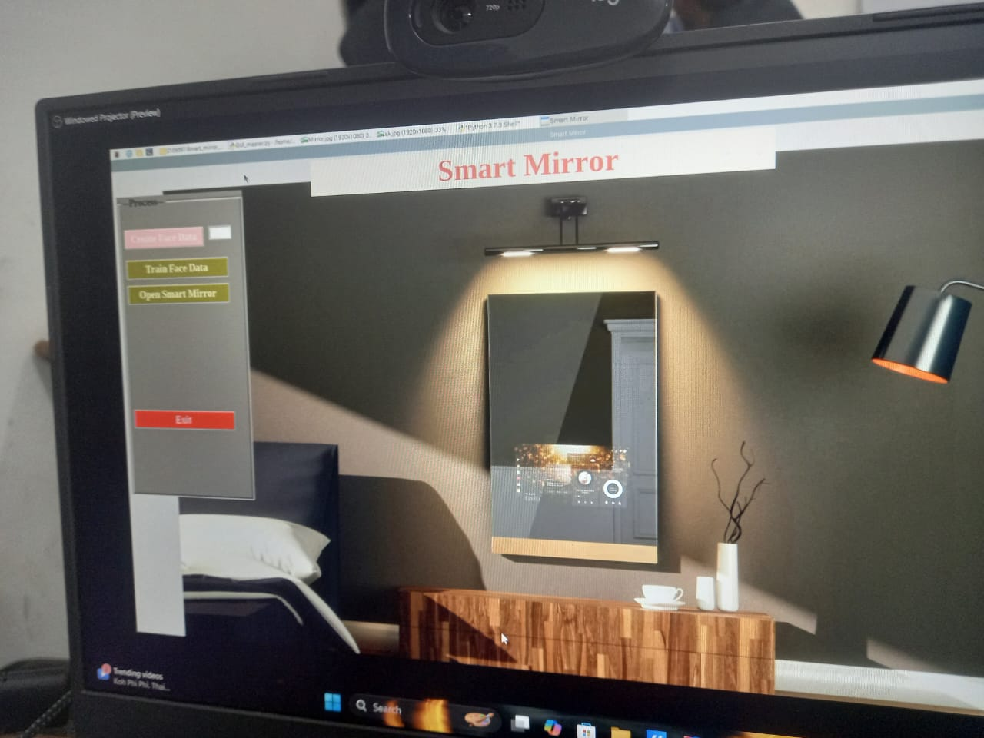

Slide 12
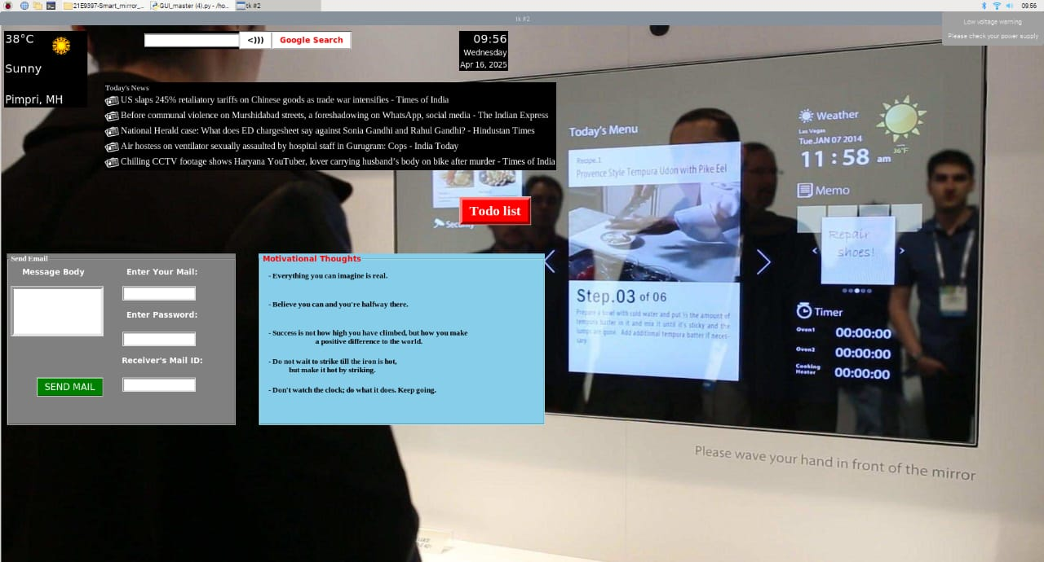

Slide 13
Conclusion
The smart mirror project aims to create an innovative interface that integrates calendar functionalities and customizable widgets, enhancing daily productivity. By carefully managing technical, operational, and business risks through comprehensive mitigation strategies, the project is positioned for success. A well-defined scope, aligned objectives, and a structured timeline will ensure efficient development and deployment. Ultimately, this project aspires to provide users with a personalized and interactive experience that seamlessly fits into their daily routines.

Slide 14
Future Work
Enhanced Voice Assistant: Integrate more advanced natural language processing (NLP) capabilities to enable multi-language support and smarter voice interactions.
Health Monitoring Integration: Add sensors to track vital signs like heart rate, temperature, or body weight, and display health stats on the mirror.
IoT Home Automation: Enable control of smart home devices (like lights, fans, or AC) directly through voice commands or gestures via the mirror.

Slide 15
References
[1] M. Anwar Hossain, Pradeep K. Attrey and Abdulmotaleb El Saddik(2007). Smart Mirror for Ambient Home Environment. \textit{Research Gate Conference Paper(RGCP)
[2] Q. Ye and D. Doermann, “Text detection and recognition in imagery: A survey,” PAMI, vol. 37, no. 7, pp. 1480–1500, 2015.
[3] Mukhopadhyay, K., Sinha, C., Saha, H. N., Rakshit, S., & Auddy, S. (2018).Smart Mirror - A Secured Application of Artificial Intelligence Recognizing Human Face and Voice.2018 IEEE 9th Annual Information Technology, Electronics and Mobile Communication Conference (IEMCON), pp. 1279–1289.
[4] Sun, Y., Geng, L., & Dan, K. (2018).Design of Smart Mirror Based on Raspberry Pi.2018 International Conference on Intelligent Transportation, Big Data & Smart City (ICITBS), pp. 77–80.

Slide 16
Thank You

